Slide 1
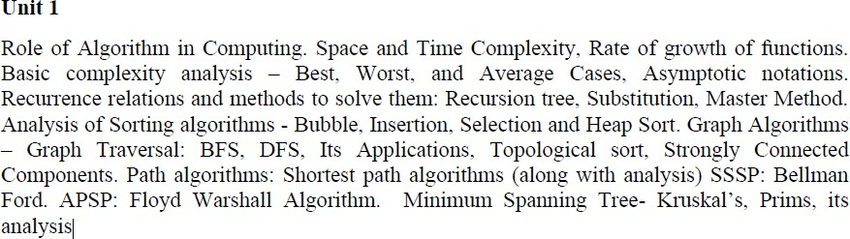
20CYS305
TIFAC – CORE in CYBER SECURITY
ALGORITHMS: DESIGN AND ANALYSIS
L-T-P-C:3-0-0-3
Pre-Requisite(s): 20CYS214 - Data Structures and Algorithms
Syllabus
ALGORITHMS: DESIGN AND ANALYSIS

Slide 2
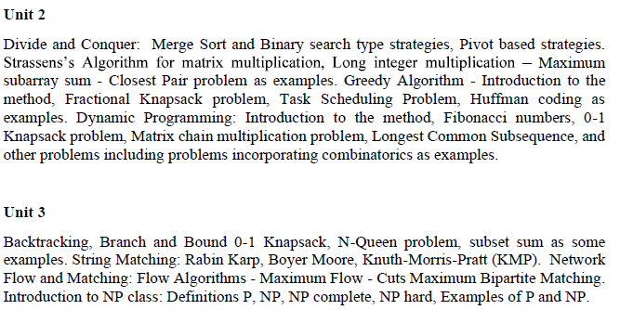
20CYS305
ALGORITHMS: DESIGN AND ANALYSIS
L-T-P-C:3-0-0-3
Pre-Requisite(s): 20CYS214 - Data Structures and Algorithms
Syllabus

Slide 3
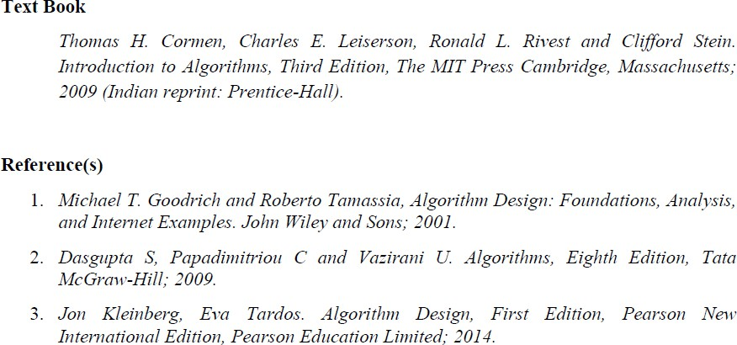
TIFAC – CORE in CYBER SECURITY
ALGORITHMS: DESIGN AND ANALYSIS

Slide 4
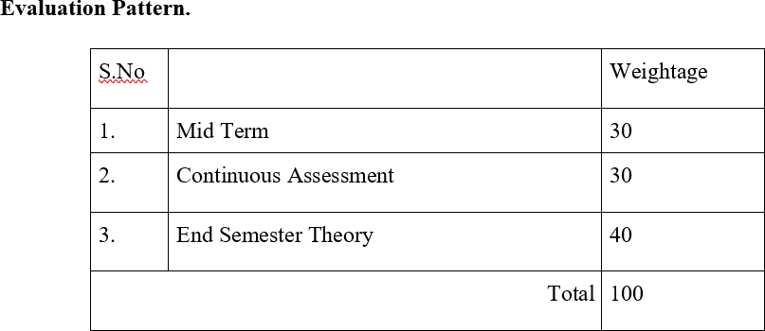
TIFAC – CORE in CYBER SECURITY
Continuous Assessment Theory (CAT):
S.NO | Assessment | Marks
1. | Quiz | 10
2. | Problem Solving | 10
3. | Class Test | 10
TOTAL |  | 30
ALGORITHMS: DESIGN AND ANALYSIS

Slide 5
TIFAC – CORE in CYBER SECURITY
An algorithm is any well-defined computational procedure that takes some value, or set of values, as input and produces some value, or set of values, as output. An algorithm is thus a sequence of computational steps that transform the input into the output.
An algorithm is a step-by-step procedure or set of rules designed to solve a specific problem or perform a particular task. It's a finite sequence of well-defined instructions that, when executed, produces a desired output from a given input.
ALGORITHMS: DESIGN AND ANALYSIS

Slide 6
Key Characteristics of Algorithms
TIFAC – CORE in CYBER SECURITY
Finiteness: An algorithm must have a finite number of steps.
Definiteness: Each step must be clearly and unambiguously defined.
Input: An algorithm should have zero or more inputs.
Output: An algorithm must produce at least one output.
Effectiveness: Each step can be carried out with finite amount of effort, in principle, by a
person using a pencil and paper.
Correctness: They should solve the problem they are designed for.
ALGORITHMS: DESIGN AND ANALYSIS

Slide 7
Importance of Algorithms in Computing
TIFAC – CORE in CYBER SECURITY
Efficiency: Algorithms optimize the use of resources such as time and memory, making
processes faster and more efficient.
Problem Solving: They provide a systematic approach to solving problems, which is essential in programming and software development.
Reusability: Well-designed algorithms can be reused in different programs and applications.
Foundation of Computing: They are fundamental to the functioning of computers and software, forming the basis for data processing and task automation.
They solve real-world problems, from sorting data to route planning.
ALGORITHMS: DESIGN AND ANALYSIS

Slide 8
Basic Components of Algorithm Design
TIFAC – CORE in CYBER SECURITY
Input: What data does the algorithm need?
Output: What result does it produce?
Control Structures: Loops, conditionals, and function calls.
Data Structures: Arrays, lists, trees, etc. Decide on the appropriate data structures for storing and managing data.
Steps in Algorithm Analysis
Correctness: Does it solve the problem correctly?
Efficiency: How fast does it run? (Time complexity)
Space Usage: How much memory does it need? (Space complexity)
ALGORITHMS: DESIGN AND ANALYSIS

Slide 9
Steps in Algorithm Analysis
TIFAC – CORE in CYBER SECURITY
Correctness: Ensure the algorithm produces the correct output for all possible valid inputs.
Analyze input size: Determine how the input affects the algorithm's performance.
Identify operations: List the basic operations the algorithm performs.
Count operations: Estimate how many times each operation is executed.
Efficiency: Evaluate the time and space complexity of the algorithm, often using Big O notation.
Time Complexity: Measure of the amount of time an algorithm takes to complete as a
function of the length of the input.
Space Complexity: Measure of the amount of memory an algorithm uses as a function of the length of the input.
Express complexity: Use Big O notation to describe the algorithm's time and space complexity.
Scalability: Assess how the algorithm performs as the size of the input grows.
Robustness: Ensure the algorithm can handle unexpected inputs gracefully.
Compare alternatives: Evaluate different approaches to solve the same problem.
ALGORITHMS: DESIGN AND ANALYSIS

Slide 10
Example: Finding the Maximum Element in an Array
TIFAC – CORE in CYBER SECURITY
Approach 1: Linear Search
Approach 2: Sorting
ALGORITHMS: DESIGN AND ANALYSIS

Slide 11
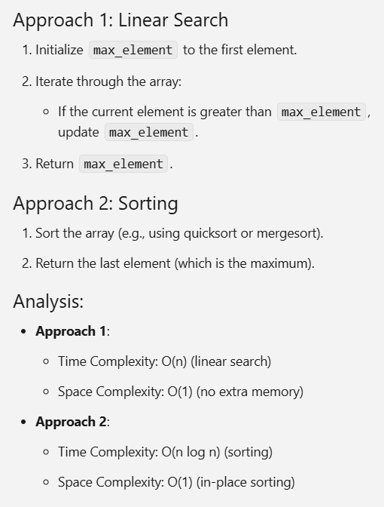
TIFAC – CORE in CYBER SECURITY
ALGORITHMS: DESIGN AND ANALYSIS

Slide 12
Linear Search
TIFAC – CORE in CYBER SECURITY
Problem
Search for a target element in an array of n integers using linear search.
Algorithm Definition
Start at the first element of the array.
Compare the current element with the target element.
If they match, return the index.
If they don't match, move to the next element.
Repeat steps 2-4 until you find the target or reach the end of the array.
ALGORITHMS: DESIGN AND ANALYSIS

Slide 13
Pseudocode
TIFAC – CORE in CYBER SECURITY
function linearSearch(array, target):
for i from 0 to n-1:
if array[i] == target: return i
return -1
3 cases of Complexity
Best,
Worst and,
Average
ALGORITHMS: DESIGN AND ANALYSIS

Slide 14
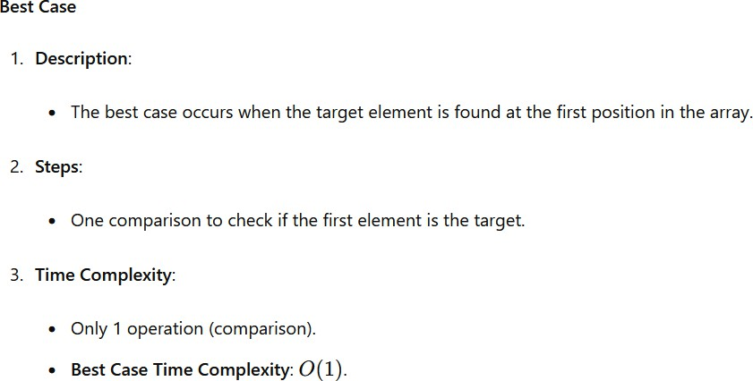
TIFAC – CORE in CYBER SECURITY
ALGORITHMS: DESIGN AND ANALYSIS

Slide 15
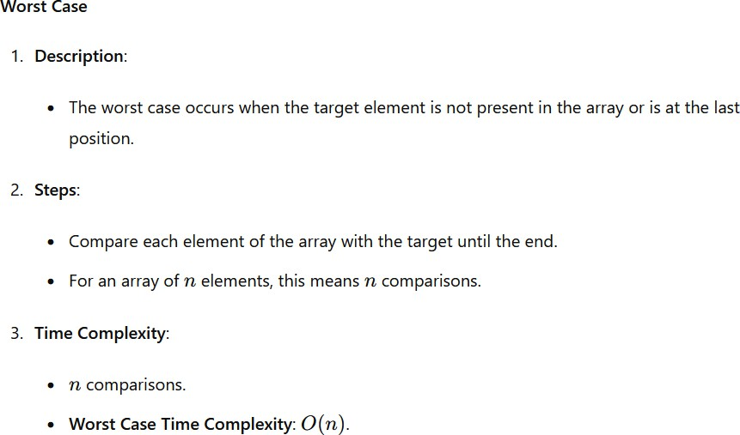
TIFAC – CORE in CYBER SECURITY
ALGORITHMS: DESIGN AND ANALYSIS

Slide 16
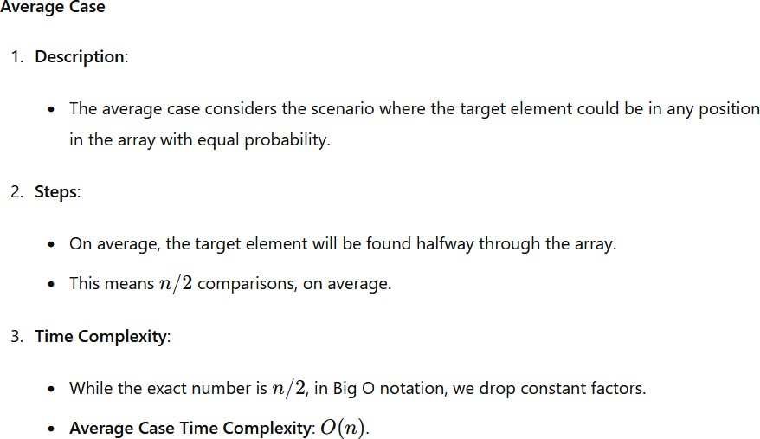
TIFAC – CORE in CYBER SECURITY
ALGORITHMS: DESIGN AND ANALYSIS

Slide 17
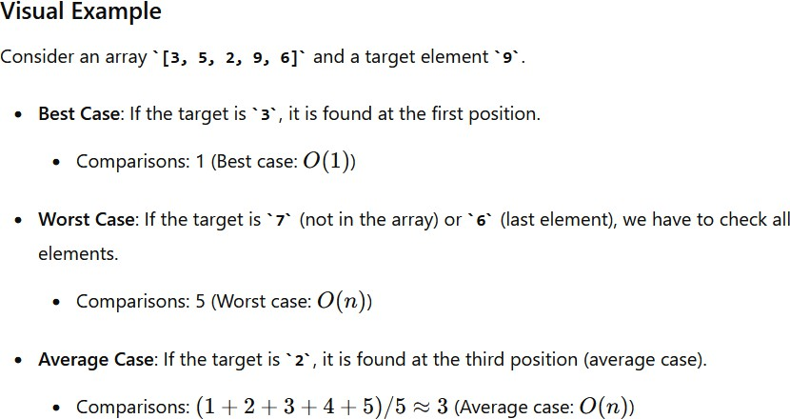
TIFAC – CORE in CYBER SECURITY
ALGORITHMS: DESIGN AND ANALYSIS

Slide 18
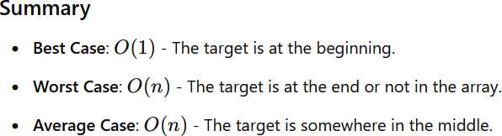
TIFAC – CORE in CYBER SECURITY
Why the time complexity is not expressed in time that is seconds or minutes?
ALGORITHMS: DESIGN AND ANALYSIS

Slide 19
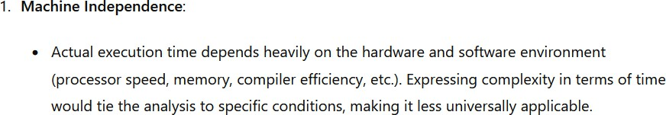
Why the time complexity is not expressed in time that is seconds or minutes?
TIFAC – CORE in CYBER SECURITY
For example, if we said "Algorithm A takes 2 seconds and Algorithm B takes 4 seconds," that might be true on one computer, but on a faster computer, it might be "1 second and 2 seconds" instead. The relative performance is the same, but the actual times differ.
ALGORITHMS: DESIGN AND ANALYSIS

Slide 20
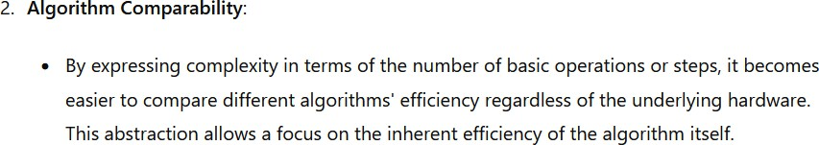
TIFAC – CORE in CYBER SECURITY
Abstraction: By using abstract units like "number of operations," we can analyze algorithms without actually implementing them. This allows us to make theoretical comparisons and improvements.
Comparability: We can compare this algorithm's O(n) complexity with another algorithm, say O(n^2) without worrying about the exact execution time.
ALGORITHMS: DESIGN AND ANALYSIS

Slide 21
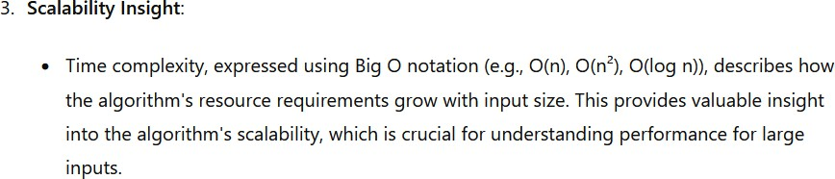
TIFAC – CORE in CYBER SECURITY
Time Complexity: Time complexity measures how the runtime of an algorithm grows as the input size increases.
Space Complexity: Space complexity measures how much additional memory an algorithm needs as the input size increases.
ALGORITHMS: DESIGN AND ANALYSIS

Slide 22
TIFAC – CORE in CYBER SECURITY
Input size focus: The real power of complexity analysis comes from understanding how an algorithm's performance changes as the input grows. This is crucial because an algorithm that works well for small inputs might become impractical for larger ones.
Scalability: Knowing the complexity is O(n) tells us that if the input size doubles, the number of operations approximately doubles, providing insight into how the algorithm scales.
ALGORITHMS: DESIGN AND ANALYSIS

Slide 23
Simplification: Using Big O notation, we ignore less significant terms and constants, simplifying the analysis and focusing on the most impactful part of the algorithm's behavior.
TIFAC – CORE in CYBER SECURITY
ALGORITHMS: DESIGN AND ANALYSIS

Slide 24
6. Big O Notation: This is the standard way to express algorithm complexity. It gives us an upper bound on the growth rate of the number of operations. Common complexities include:
TIFAC – CORE in CYBER SECURITY
O(1): Constant time (best)
O(log n): Logarithmic time
O(n): Linear time
O(n log n): Linearithmic time
O(n^2): Quadratic time
O(2^n): Exponential time (worst)
ALGORITHMS: DESIGN AND ANALYSIS

Slide 25
TIFAC – CORE in CYBER SECURITY
ALGORITHMS: DESIGN AND ANALYSIS

Slide 26
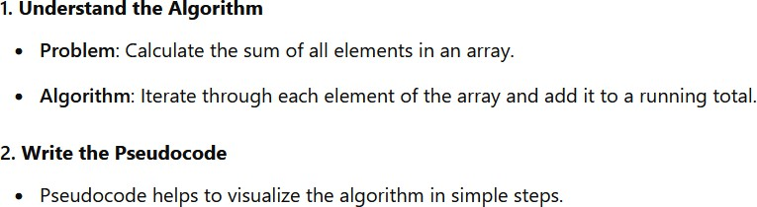
Step-by-Step Procedure to Express Algorithm Complexity
TIFAC – CORE in CYBER SECURITY
ALGORITHMS: DESIGN AND ANALYSIS

Slide 27
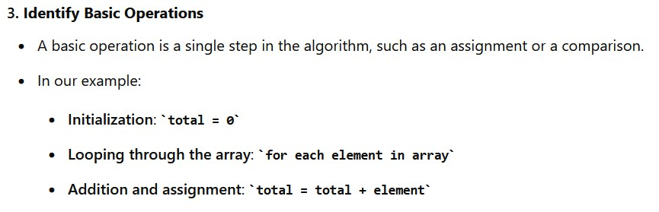
function sumArray(array): total = 0
for each element in array:
TIFAC – CORE in CYBER SECURITY
total = total + element return total
ALGORITHMS: DESIGN AND ANALYSIS

Slide 28
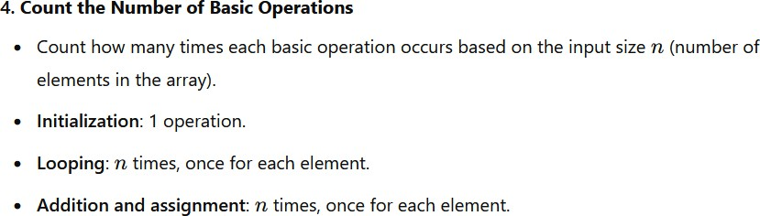
TIFAC – CORE in CYBER SECURITY
ALGORITHMS: DESIGN AND ANALYSIS

Slide 29
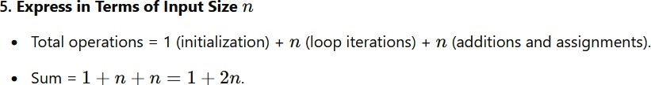
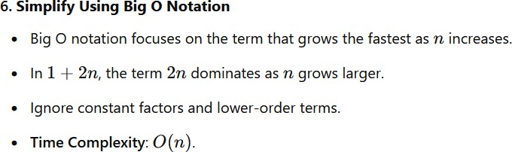
TIFAC – CORE in CYBER SECURITY
ALGORITHMS: DESIGN AND ANALYSIS

Slide 30
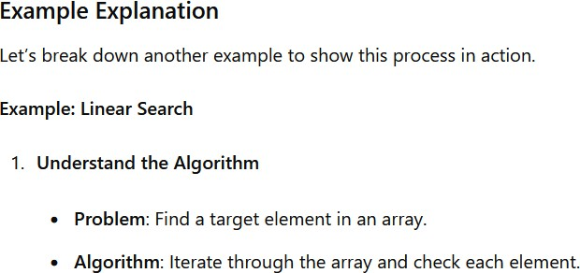
TIFAC – CORE in CYBER SECURITY
ALGORITHMS: DESIGN AND ANALYSIS

Slide 31
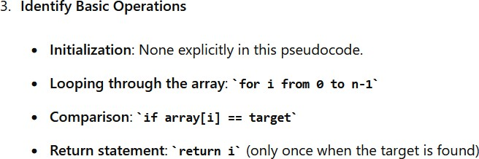
function linearSearch(array, target): for i from 0 to n-1:
if array[i] == target: return i
TIFAC – CORE in CYBER SECURITY
return -1
ALGORITHMS: DESIGN AND ANALYSIS

Slide 32
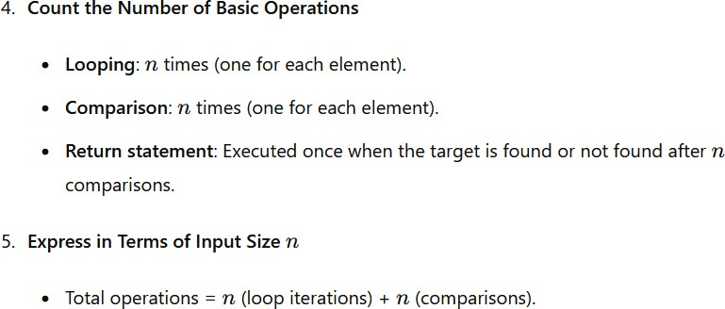
TIFAC – CORE in CYBER SECURITY
ALGORITHMS: DESIGN AND ANALYSIS

Slide 33
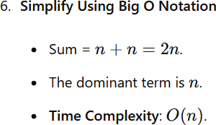
TIFAC – CORE in CYBER SECURITY
ALGORITHMS: DESIGN AND ANALYSIS

Slide 34
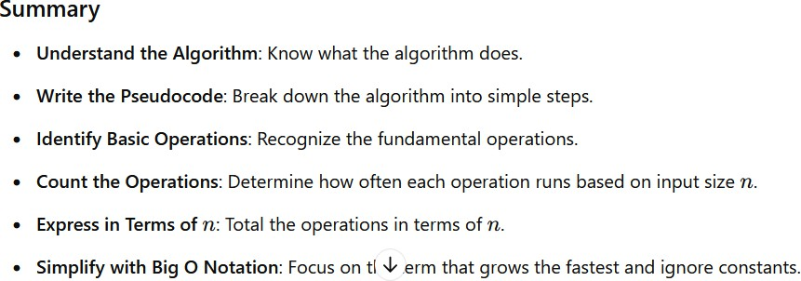
TIFAC – CORE in CYBER SECURITY
ALGORITHMS: DESIGN AND ANALYSIS

Slide 35
Time Complexity: Time complexity measures how the runtime of an algorithm grows as the input size increases.
TIFAC – CORE in CYBER SECURITY
Space Complexity: Space complexity measures how much additional memory an algorithm needs as the input size increases.
Input Size (n)
The input size, denoted as n, represents the size of the problem instance.
For example:
If we’re sorting an array, n is the number of elements in the array.
If we’re searching in a graph, n is the number of nodes or edges.
ALGORITHMS: DESIGN AND ANALYSIS

Slide 36
Runtime Function T(n)
TIFAC – CORE in CYBER SECURITY
We measure an algorithm’s efficiency using a runtime function denoted as T(n).
It represents the time (or other resources) required by the algorithm to solve a problem of
size n.
For example, if we’re sorting an array, T(n) could be the time taken by the sorting algorithm.
ALGORITHMS: DESIGN AND ANALYSIS

Slide 37
What Is the Rate of Growth?
TIFAC – CORE in CYBER SECURITY
When we analyze algorithms, we want to estimate how their performance changes as the input size increases.
The rate of growth helps us understand how quickly the algorithm’s runtime or resource usage (such as memory) increases concerning the input size.
We mainly focus on time complexity, which measures how long an algorithm takes to run.
ALGORITHMS: DESIGN AND ANALYSIS

Slide 38
Purpose of rate of growth: The rate of growth helps us understand how an algorithm's performance changes as the input size increases. This is crucial for comparing algorithms and predicting their behavior on large datasets.
TIFAC – CORE in CYBER SECURITY
ALGORITHMS: DESIGN AND ANALYSIS

Slide 39
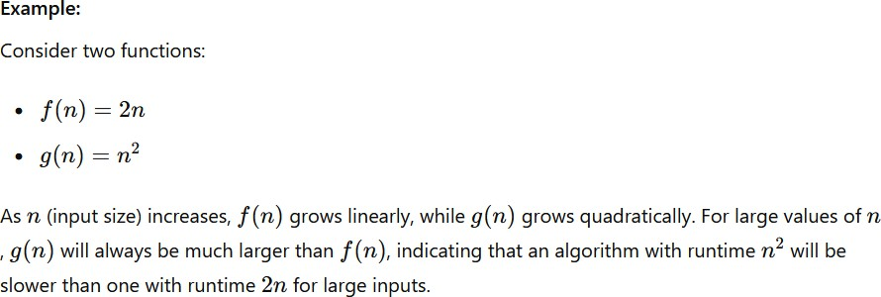
TIFAC – CORE in CYBER SECURITY
ALGORITHMS: DESIGN AND ANALYSIS

Slide 40
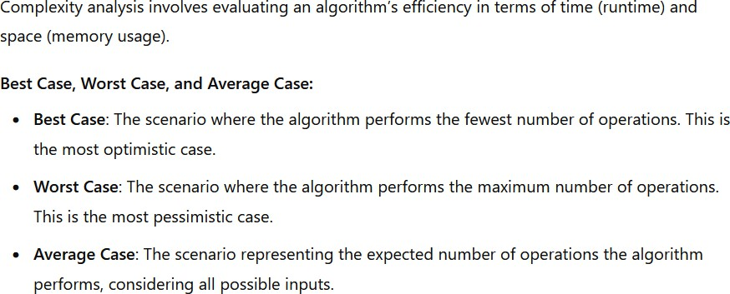
Basic Complexity Analysis
TIFAC – CORE in CYBER SECURITY
ALGORITHMS: DESIGN AND ANALYSIS

Slide 41
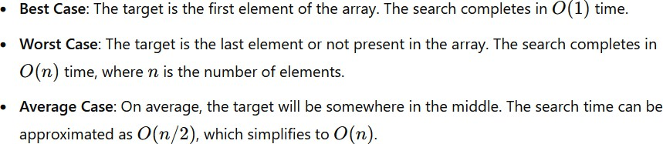
Consider a simple linear search algorithm to find an element in an array.
TIFAC – CORE in CYBER SECURITY
def linear_search(arr, target): for i in range(len(arr)):
if arr[i] == target:
return i return -1
ALGORITHMS: DESIGN AND ANALYSIS

Slide 42
Asymptotic Analysis
TIFAC – CORE in CYBER SECURITY
Defining the exact runtime function T(n) is challenging because it depends on various factors (machine speed, programming language, etc.).
Instead, we use asymptotic analysis, which focuses on how the runtime grows as n becomes large.
We’re interested in the dominant term that affects the runtime the most.
ALGORITHMS: DESIGN AND ANALYSIS

Slide 43
Asymptotic Notations
Asymptotic notations describe the running time of an algorithm as a function of the input size, providing a way to compare the efficiency of different algorithms. The most common notations are:
TIFAC – CORE in CYBER SECURITY
ALGORITHMS: DESIGN AND ANALYSIS

Slide 44
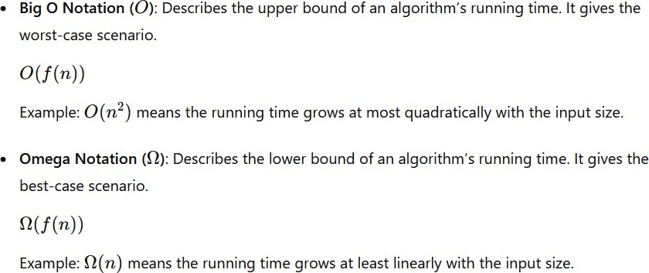
TIFAC – CORE in CYBER SECURITY
ALGORITHMS: DESIGN AND ANALYSIS

Slide 45
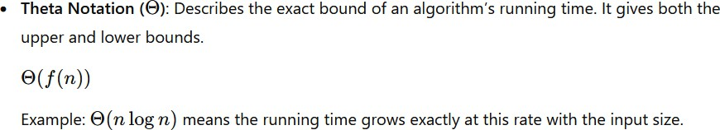
TIFAC – CORE in CYBER SECURITY
Theta notation (Θ) provides a tight bound on the running time of an algorithm. It means that the running time grows at the same rate as the given function both in the upper and lower bounds.
ALGORITHMS: DESIGN AND ANALYSIS

Slide 46
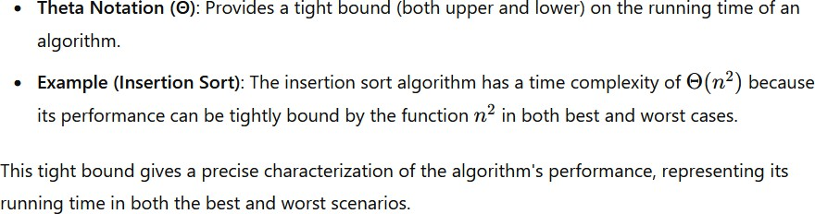
TIFAC – CORE in CYBER SECURITY
ALGORITHMS: DESIGN AND ANALYSIS

Slide 47
Find the minimum element in an array of ( n ) integers.
TIFAC – CORE in CYBER SECURITY
function findMin(array):
min = array[0]
for i from 1 to n-1: if array[i] < min: min = array[i]
return min
ALGORITHMS: DESIGN AND ANALYSIS

Slide 48
1. Identify Basic Operations:
TIFAC – CORE in CYBER SECURITY
Initialization: min = array[0] - (1 operation)
Looping through the array: for i from 1 to n-1
- ( n-1 ) operations
Comparison: if array[i] < min - ( n-1 ) operations
Assignment: min = array[i] - (at most ( n-1) operations
ALGORITHMS: DESIGN AND ANALYSIS

Slide 49
2. Count the Number of Operations
TIFAC – CORE in CYBER SECURITY
Total operations = 1 (initialization) + ( n-1 ) loop iterations + ( n-1 )comparisons + at most
( n-1)assignments
Sum = ( 1 + (n-1) + (n-1) + (n-1) = 3n - 2 )
Sum = 3n-2
ALGORITHMS: DESIGN AND ANALYSIS

Slide 50
3. Simplify Using Big O Notation:
TIFAC – CORE in CYBER SECURITY
The dominant term is ( n ).
Time Complexity O(n)
ALGORITHMS: DESIGN AND ANALYSIS

Slide 51
Example 2: Checking if an Array is Sorted
TIFAC – CORE in CYBER SECURITY
Check if an array of ( n ) integers is sorted in ascending order.
function isSorted(array): for i from 0 to n-2:
if array[i] > array[i+1]: return false
return true
ALGORITHMS: DESIGN AND ANALYSIS

Slide 52
1. Identify Basic Operations:
TIFAC – CORE in CYBER SECURITY
Looping through the array: for i from 0 to n-2
Comparison: if array[i] > array[i+1]
Return statement: return false
2. Count the Number of Operations:
Total operations = ( n-1 ) (loop iterations) + ( n-1 ) (comparisons)
( n-1) operations
( n-1) operations
(executed at most once)//negligible
ALGORITHMS: DESIGN AND ANALYSIS

Slide 53
3. Simplify Using Big O Notation:
TIFAC – CORE in CYBER SECURITY
Sum = (n-1) + (n-1) = 2(n-1)
The dominant term is ( n).
Time Complexity: O(n)
ALGORITHMS: DESIGN AND ANALYSIS

Slide 54
Example 4: Counting the Number of Elements Greater Than a Given Value
TIFAC – CORE in CYBER SECURITY
Problem : Count the number of elements in an array that are greater than a given value (x).
function countGreaterThan(array, x):
count = 0
for each element in array: if element > x:
count = count + 1 return count
ALGORITHMS: DESIGN AND ANALYSIS

Slide 55
1. Identify Basic Operations:
TIFAC – CORE in CYBER SECURITY
Initialization: count = 0 (1 operation)
Looping through the array: for each element in array
Comparison: if element > x (n) operations
Increment: count = count + 1 at most (n) operations
Return statement: return count (1 operation)
(n) operations
ALGORITHMS: DESIGN AND ANALYSIS

Slide 56
2. Count the Number of Operations:
TIFAC – CORE in CYBER SECURITY
Total operations = 1 (initialization) + (n) (loop iterations) +(n) (comparisons) + at most (n)
(increments) + 1 (return)
Sum = ( 1 + n + n + n + 1 = 3n + 2)
3. Simplify Using Big O Notation:
The dominant term is (n).
Time Complexity: O(n)
ALGORITHMS: DESIGN AND ANALYSIS

Slide 57
Find the Complexity
TIFAC – CORE in CYBER SECURITY
def print_all_pairs(arr):
for i in arr: for j in arr:
print(i, j)
ALGORITHMS: DESIGN AND ANALYSIS

Slide 58
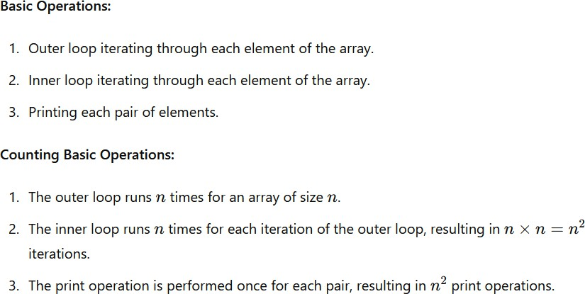
TIFAC – CORE in CYBER SECURITY
ALGORITHMS: DESIGN AND ANALYSIS

Slide 59
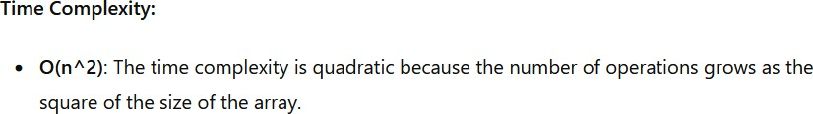
TIFAC – CORE in CYBER SECURITY
ALGORITHMS: DESIGN AND ANALYSIS

Slide 60
def print_all_triplets(arr): for i in arr:
for j in arr: for k in arr: print(i, j, k)
TIFAC – CORE in CYBER SECURITY
ALGORITHMS: DESIGN AND ANALYSIS

Slide 61
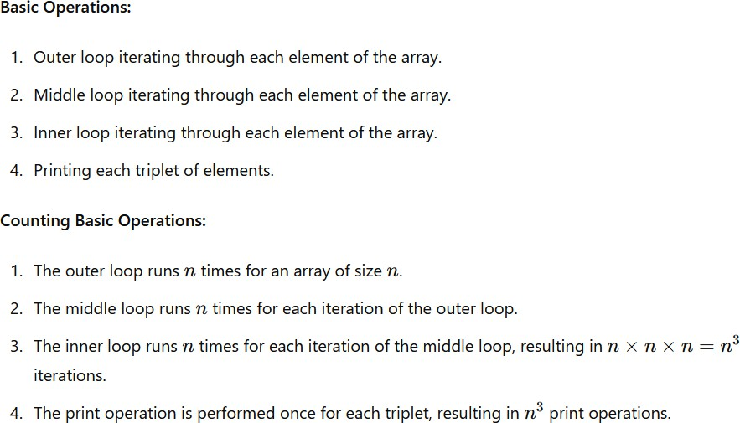
TIFAC – CORE in CYBER SECURITY
ALGORITHMS: DESIGN AND ANALYSIS

Slide 62
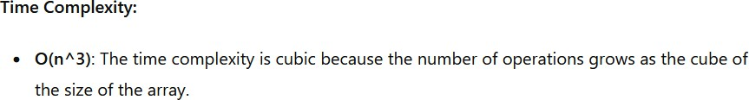
TIFAC – CORE in CYBER SECURITY
ALGORITHMS: DESIGN AND ANALYSIS

Slide 63
TIFAC – CORE in CYBER SECURITY
def fibonacci(n): if n <= 1:
return n else:
return fibonacci(n - 1) + fibonacci(n - 2)
ALGORITHMS: DESIGN AND ANALYSIS

Slide 64
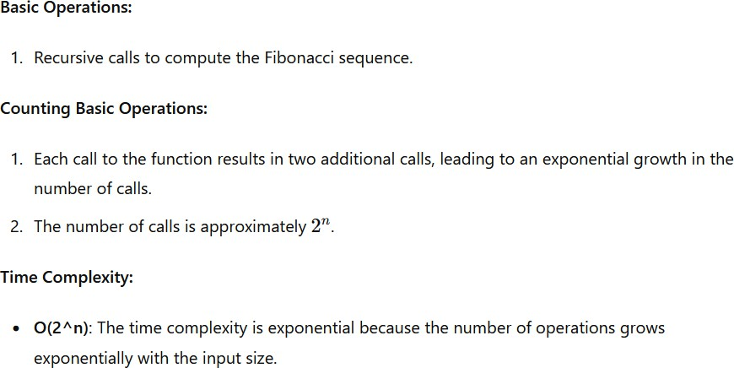
Exponential Time Complexity (O(2^n))
TIFAC – CORE in CYBER SECURITY
ALGORITHMS: DESIGN AND ANALYSIS

Slide 65
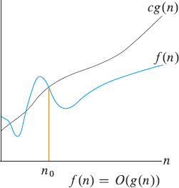
Asymptotic notation: formal defenitions
TIFAC – CORE in CYBER SECURITY
Big O notation is used to describe the upper bound of the time complexity of an algorithm. It provides a way to express how the runtime of an algorithm grows relative to the input size in the worst-case scenario.
Figure 3.2 a
ALGORITHMS: DESIGN AND ANALYSIS

Slide 66
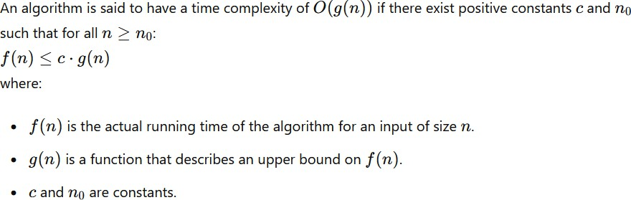
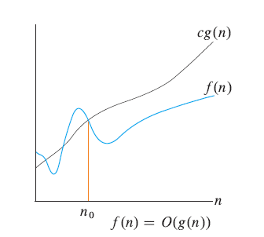
TIFAC – CORE in CYBER SECURITY
ALGORITHMS: DESIGN AND ANALYSIS

Slide 67
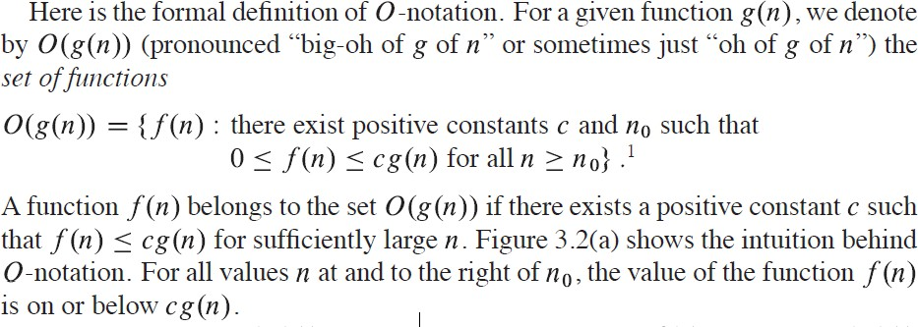
TIFAC – CORE in CYBER SECURITY
A formal definition from the syllabus text
ALGORITHMS: DESIGN AND ANALYSIS

Slide 68
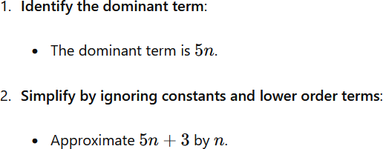
Find the constants C and n0 for
TIFAC – CORE in CYBER SECURITY
f(n) = 5n+3
f(n) =O(?)
5n+3 <= c.g(n)
ALGORITHMS: DESIGN AND ANALYSIS

Slide 69
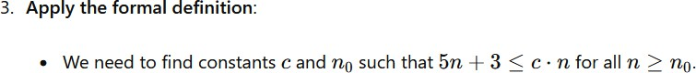
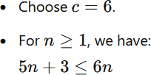
5n +3 <= c. n
TIFAC – CORE in CYBER SECURITY
apply diff values for c , c=1, c=2, c=3, ….
ALGORITHMS: DESIGN AND ANALYSIS

Slide 70
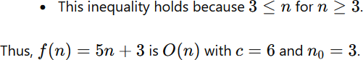
TIFAC – CORE in CYBER SECURITY
ALGORITHMS: DESIGN AND ANALYSIS

Slide 71
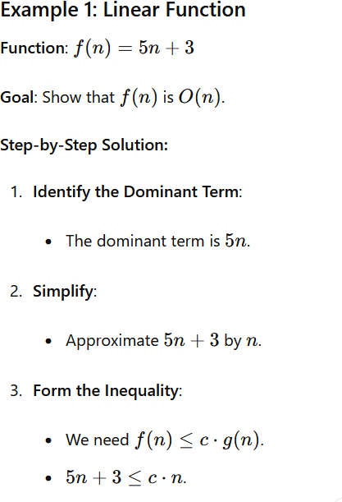
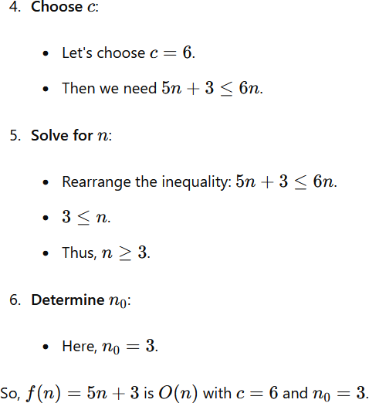
TIFAC – CORE in CYBER SECURITY
ALGORITHMS: DESIGN AND ANALYSIS

Slide 72
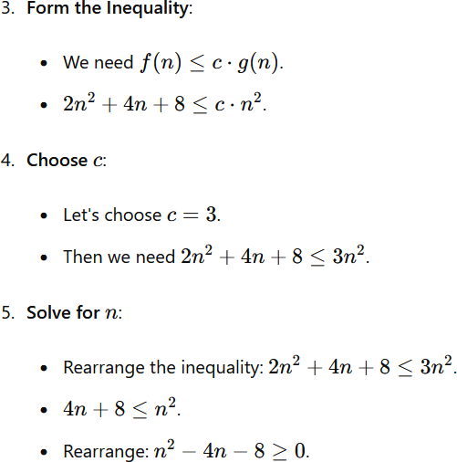
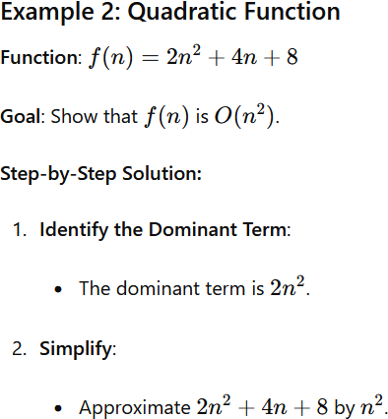
TIFAC – CORE in CYBER SECURITY
ALGORITHMS: DESIGN AND ANALYSIS

Slide 73
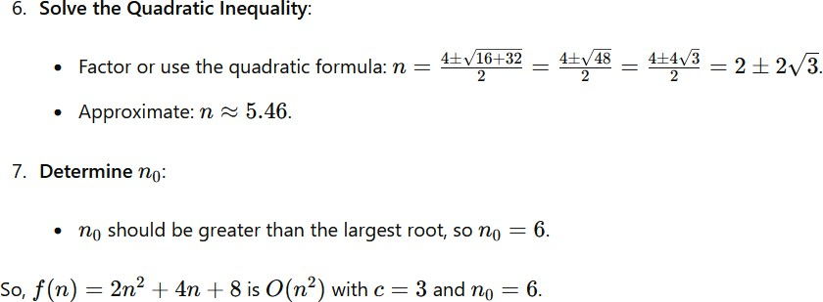
TIFAC – CORE in CYBER SECURITY
ALGORITHMS: DESIGN AND ANALYSIS

Slide 74
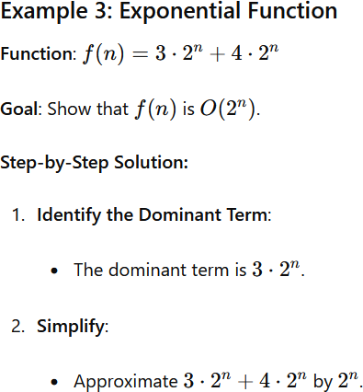
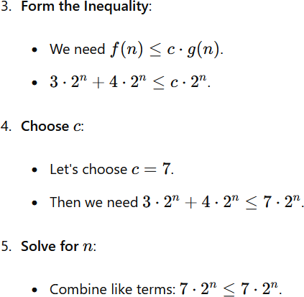
TIFAC – CORE in CYBER SECURITY
ALGORITHMS: DESIGN AND ANALYSIS

Slide 75
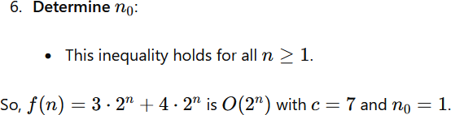
TIFAC – CORE in CYBER SECURITY
ALGORITHMS: DESIGN AND ANALYSIS

Slide 76

TIFAC – CORE in CYBER SECURITY
ALGORITHMS: DESIGN AND ANALYSIS

Slide 77

TIFAC – CORE in CYBER SECURITY
ALGORITHMS: DESIGN AND ANALYSIS

Slide 78


TIFAC – CORE in CYBER SECURITY
ALGORITHMS: DESIGN AND ANALYSIS

Slide 79

TIFAC – CORE in CYBER SECURITY
ALGORITHMS: DESIGN AND ANALYSIS

Slide 80
In Omega we are considering the lower bound but we have to select the Greatest lower bound But in Big O we consider the least upper bound
TIFAC – CORE in CYBER SECURITY
ALGORITHMS: DESIGN AND ANALYSIS

Slide 81

TIFAC – CORE in CYBER SECURITY
ALGORITHMS: DESIGN AND ANALYSIS

Slide 82

TIFAC – CORE in CYBER SECURITY
ALGORITHMS: DESIGN AND ANALYSIS

Slide 83


TIFAC – CORE in CYBER SECURITY
We have to choose the greatest lower bound that Is the closest.
C=1, 2,3,4,5 will satisfy, select 5
ALGORITHMS: DESIGN AND ANALYSIS

Slide 84

TIFAC – CORE in CYBER SECURITY
ALGORITHMS: DESIGN AND ANALYSIS

Slide 85


TIFAC – CORE in CYBER SECURITY
ALGORITHMS: DESIGN AND ANALYSIS

Slide 86

TIFAC – CORE in CYBER SECURITY
ALGORITHMS: DESIGN AND ANALYSIS

Slide 87

TIFAC – CORE in CYBER SECURITY
ALGORITHMS: DESIGN AND ANALYSIS

Slide 88

TIFAC – CORE in CYBER SECURITY
ALGORITHMS: DESIGN AND ANALYSIS

Slide 89

TIFAC – CORE in CYBER SECURITY
ALGORITHMS: DESIGN AND ANALYSIS

Slide 90

TIFAC – CORE in CYBER SECURITY
ALGORITHMS: DESIGN AND ANALYSIS

Slide 91

TIFAC – CORE in CYBER SECURITY
n = 0 will also true for this case,
then why choose n= 4 ?
ALGORITHMS: DESIGN AND ANALYSIS

Slide 92

TIFAC – CORE in CYBER SECURITY
why n0 = 4 was chosen, and why n0 = 0 isn't actually correct in this case.
ALGORITHMS: DESIGN AND ANALYSIS

Slide 93

It is right that the inequality is technically true for n = 0, but it's not strictly greater, and it fails for n = 1, 2, and 3. In Big Omega notation, we need to find the point from which the inequality consistently holds for all larger values.
TIFAC – CORE in CYBER SECURITY
ALGORITHMS: DESIGN AND ANALYSIS

Slide 94

TIFAC – CORE in CYBER SECURITY
ALGORITHMS: DESIGN AND ANALYSIS

Slide 95

TIFAC – CORE in CYBER SECURITY
ALGORITHMS: DESIGN AND ANALYSIS

Slide 96

TIFAC – CORE in CYBER SECURITY
ALGORITHMS: DESIGN AND ANALYSIS

Slide 97

Understanding Upper and Lower Bounds in Asymptotic Notation
In Big O notation, we are interested in the least upper bound of the growth rate of a function, while in Big Omega notation, we are concerned with the greatest lower bound.
TIFAC – CORE in CYBER SECURITY
ALGORITHMS: DESIGN AND ANALYSIS

Slide 98


TIFAC – CORE in CYBER SECURITY
ALGORITHMS: DESIGN AND ANALYSIS

Slide 99

TIFAC – CORE in CYBER SECURITY
ALGORITHMS: DESIGN AND ANALYSIS

Slide 100

Another Explanation
TIFAC – CORE in CYBER SECURITY
ALGORITHMS: DESIGN AND ANALYSIS

Slide 101


TIFAC – CORE in CYBER SECURITY
Figure 3.2 C
ALGORITHMS: DESIGN AND ANALYSIS

Slide 102

TIFAC – CORE in CYBER SECURITY
ALGORITHMS: DESIGN AND ANALYSIS

Slide 103

TIFAC – CORE in CYBER SECURITY
ALGORITHMS: DESIGN AND ANALYSIS

Slide 104

TIFAC – CORE in CYBER SECURITY
ALGORITHMS: DESIGN AND ANALYSIS

Slide 105

TIFAC – CORE in CYBER SECURITY
ALGORITHMS: DESIGN AND ANALYSIS

Slide 106

TIFAC – CORE in CYBER SECURITY
ALGORITHMS: DESIGN AND ANALYSIS

Slide 107

TIFAC – CORE in CYBER SECURITY
ALGORITHMS: DESIGN AND ANALYSIS

Slide 108

TIFAC – CORE in CYBER SECURITY
ALGORITHMS: DESIGN AND ANALYSIS

Slide 109

TIFAC – CORE in CYBER SECURITY
ALGORITHMS: DESIGN AND ANALYSIS

Slide 110

TIFAC – CORE in CYBER SECURITY
ALGORITHMS: DESIGN AND ANALYSIS

Slide 111

TIFAC – CORE in CYBER SECURITY
ALGORITHMS: DESIGN AND ANALYSIS

Slide 112

TIFAC – CORE in CYBER SECURITY
ALGORITHMS: DESIGN AND ANALYSIS

Slide 113

TIFAC – CORE in CYBER SECURITY
ALGORITHMS: DESIGN AND ANALYSIS

Slide 114

TIFAC – CORE in CYBER SECURITY
ALGORITHMS: DESIGN AND ANALYSIS

Slide 115


Little Oh notation - o
TIFAC – CORE in CYBER SECURITY
In “o” notation the function f(n) becomes insignificant
relative to g(n) as n gets large:
ALGORITHMS: DESIGN AND ANALYSIS

Slide 116



Little-omega Notation -
TIFAC – CORE in CYBER SECURITY
ALGORITHMS: DESIGN AND ANALYSIS

Slide 117

TIFAC – CORE in CYBER SECURITY
ALGORITHMS: DESIGN AND ANALYSIS

